Slide 1
Jeff Salvage
Teaching Professor
College of Computing & Informatics
jks29@drexel.edu
2020 – 2021 OVERVIEW

Slide 2
What Is Senior Project – Deep Dive
3 Quarter Capstone Project
Projects Domains:
Game
Corporate Sponsored
Non-Profit
Research oriented
Entrepreneurial
Groups typically contain 5-6 students
Groups are primarily composed of students from the following majors:
Computer Science
Software Engineering
Data Science
Information Systems
CST

Slide 3

All projects start with a solid abstract Abstracts should state a problem and a proposed direction to solve it.
Example: TheraWii
There is an emerging trend toward using video games as a means of increasing patient engagement in physical therapy. This trend is primarily driven by the newest generation of consumer console systems which use motion-based controls. However, clinical research into the efficacy of these systems is hindered by the inability to automatically collect data from systems and software which were not intended for this purpose.
We will create a new piece of software that gives researchers the ability to experiment and quantitatively assess the value of game-based therapy. This software will provide an extensible framework for games or interactive experiments as well as an example suite of activities. This framework will allow researchers to easily gather data from motion-based input controls such as the Wii Remote. Various reporting methods and analysis tools will be provided for the gathered data.

Slide 4
Roles
Course Coordinator
Faculty Advisors
Technical Advisors
External Stakeholder
CCI Team Members
Drexel Team Members

Slide 5
Roles - Course Coordinator
Facilitates communication to:
students
faculty advisors
corporate partners
external projects

Slide 6
Roles - Faculty Advisor
Instructor of the course
Assigns grade
Weekly meetings with the group
Guides the development process

Slide 7
Roles - Technical Advisor
Not required
Provides technical advice to augment faculty advisor knowledge

Slide 8
Roles - External Stakeholder
All projects require an external stakeholder
Guide the requirements process
May provide:
technical knowledge
computing resources

Slide 9
Roles - CCI Team Members
CCI Students who have met the course prerequisite of completing one of the following with a D or better:
CS 451
INFO 324
INFO 442
SE 310

Slide 10
Roles - Drexel Team Members
Non CCI students from other colleges within the university can participate in CCI’s Senior Project
Grade for student is determined by faculty advisor and sent to external college advisors
COE and BioMed are often sources

Slide 11
Teams
Solely CCI team members
Multidisciplinary
Collaborative
External

Slide 12
Teams – Solely CCI team members
It is what it is, all team members are from CCI

Slide 13
Teams – Multidisciplinary
Students from other colleges join the CCI project

Slide 14
Teams - Collaborative
Students may wish to work collaboratively with a team from another college at Drexel.
DIGM is often partnered with CCI to develop games / polished mobile apps.
COE can be partnered with as well
Grades are determined by respective faculty advisors with some vested interest between the teams.

Slide 15
Teams – Collaborative - DIGM
DIGM project ideas can be found at: https://discord.gg/gVegd6A
If you have a CCI project that would benefit from DIGM students Discord is where to go to recruit help.

Slide 16
Teams - External
Students may join projects from other colleges at Drexel.
Multidisciplinary
Sign up for CCI Senior Project
External Advisor sends grade to Jeff Salvage at the end of the quarter
CCI has no say in the grading

Slide 17
Project Deliverables
All projects require a minimum of:
giving a formal presentation at the end of each quarter
creating a research-style poster at the end of the project
creating a single-page website for the project from the class template
creating a formal requirements document
creating a formal design document
creating a formal acceptance test plan
creating a project plan

Slide 18
Final Competition
Poster Presentation judged for best overall projects as well as individual categories (subject to change):
Game
Corporate Sponsored
Non-Profit
Research oriented
Entrepreneurial

Slide 19
Software Development Methodologies
No set software development methodology is required.
Many groups follow Agile methodologies, but the formal deliverables are still required.

Slide 20
Corporate Partner Projects
CCI Corporate Partners have proposed numerous projects.
These have yet to be proposed, but we’ll start an ongoing list.

Slide 21
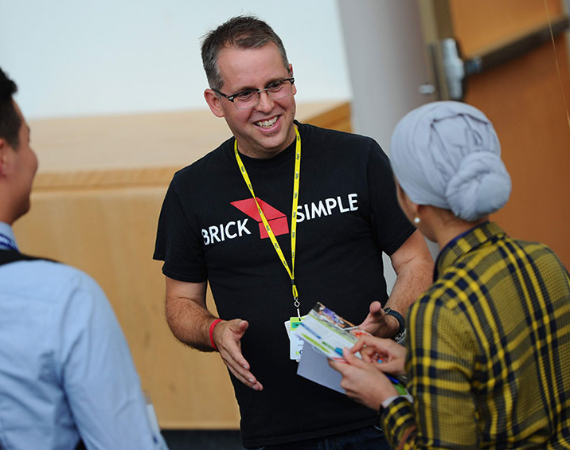
Corporate Partners Advantage
Develop a relationship with companies highly interested in hiring you when you graduate.
Test drive the corporate culture.

Slide 22
Research Oriented Projects
Do not fit the mold of typical software engineering projects.
Students should work closely with a domain expert in the research field.
End product might be a research paper instead of a formal software artifact.

Slide 23
Entrepreneurial Projects
Startups may not have a traditional stakeholder.
They should have advisors.
The Baiada Center is the place to go.

Slide 24
Entrepreneurial Projects
Signup for StartupTree (our online entrepreneurship community and resource platform) and register the project.
Signup at https://baiada.startuptree.co/ and then go to Discover/Projects to register the project in the platform.

Slide 25
Entrepreneurial Projects
When ready, submit an Idea Assessment Questionnaire in StartupTree. Go to Events/Applications, look for the Idea Assessment Questionnaire and then hit “Apply”.
They’ll get in touch to schedule a meeting with the team to review the idea and discuss how they can best help.

Slide 26
Entrepreneurial Projects
Take a look around the StartupTree platform for upcoming events, competitions and program applications.
You can also seek a mentor, find team members and apply to startup job opportunities.

Slide 27
Project Conception What makes a good project?
Projects need:
a well-defined goal, stable
a reasonable chance for success
software engineering style vs research style (either can be made to work however)

Slide 28

Good Examples of Past Projects
With the increasing popularity of IOT devices, smart homes have started to become a “norm” for most families. Smart homes help families with even the simplest things including lighting. Smart lighting can be helpful but in current designs smart lighting only works when power switches are on, otherwise they act as “dumb” lights.
StratHub gives the users the ability to always control their smart lights. Users can control their smart lights without the worry of a switch through an app, or voice control through Google Assistant or Amazon Alexa. StratHub currently works with Raspberry Pi Zero W and LiFX Bulbs. StratHub provides extendable software so developers can work with any light, microcontroller, and management software. StratHub also uses a dynamic loading library to easily store and manipulate data and controls.
StratHub partnered with a building developer to create a system that was a value-added product for their apartment buildings. They interacted heavily with the client throughout the duration of the project.
Example:
StratHub

Slide 29

Good Examples of Past Projects
The video gaming industry consistently reaches new heights in visual appeal. However, a group of would-be gamers, the visually impaired, are left behind. Goal Ball is a real-world game played by individuals world-wide from a local level to the Paralympics. Specifically designed for the visually impaired, the Goal Ball application provides a replication of the real-world game play with audio and sensory feedback providing a fair, competitive environment and an entertaining experience for the audience.
Students partnered with Overbrook School for the Blind. Students went out to the school with no real idea of what was possible or even desired. After interviewing visually-impaired students, the project idea was conceived. Frequent visits with the stakeholder educated our students and provided meaningful, iterative feedback.
Overbrook did not supply any technical expertise, but critical domain knowledge. The end product was a very playable game where the students were jumping out of their seats and yelling expletives at the game.
Example:
Goal Ball

Slide 30

Good Examples of Past Projects
Climate Central (a non-profit science and news organization) uses interactive demos on their website to present complex climate data in a format the average person can easily understand.
A demo could display cities at risk due to projected changes in sea level. Demos were created from scratch with no easy method for reusing common elements.
WAVED (Web App for Visualizing Environmental Data) is a web-based development environment that enables users of all technical skill levels to create these demos via a graphical user interface. Provided with a set of geospatial data, WAVED allows users to decide how to visualize the data on a map. Users can add interactive elements, such as buttons or sliders, to trigger user-defined events that manipulate how the data is displayed.
Once finished, users can export their demos in the form of automatically generated JavaScript code.
Example:
WAVED

Slide 31

Intellectual Property
Drexel students typically own their IP.
In the case of an external stakeholder:
Drexel students sign their IP over to Drexel in the fall.
Drexel then transfers the IP to the Corporate Partner / stakeholder at the end of the year.

Slide 32
Logistics
Students sign up for CI 491 for the fall for either Monday / Tuesday night.
All students in a group must be able to meet the night they register.
Students must be able to meet that night all year.
Students may schedule with a faculty advisor to meet at another time for the schoolyear if everyone agrees.

Slide 33
Logistics
Students are highly recommended to select a project over the summer.
All students must be members of a team by the first night of class in the Fall quarter.
Teams with less than 6 members may have a student assigned to them, so it’s best to organize teams with 6 members.

Slide 34
Logistics
The time allotted for senior project (either Monday or Tuesday) is for team members to meet in person.
Within the 3-hr period, teams may meet with advising instructor for 30 min.
The remaining 2 hr 30 min is for the team to meet in person.
Do not schedule any other activities for that time. The instructor may request your attendance for the 3 hr in any week.

Slide 35
Logistics
Non CCI students joining CCI projects register for their Senior project and the faculty advisor sends their grade to the external senior project advisor.

Slide 36
Project & Team Formation
Join Discord and engage with ~180 CCI Senior Project participants.
https://discord.gg/UwYEJxt

Slide 37
Project & Team Formation
Use Discord to:
Discuss project ideas
Recruit team members

Slide 38
Formally Selecting a Project
Contact Professor Jeff Salvage at jks29@drexel.edu.
Limited email access from July 17th – August 4th.
List all team members, meeting night, preferred faculty advisor.

Slide 39
Formally Proposing a Project
Students may propose a project assuming they have a valid stakeholder.
Contact Professor Jeff Salvage with the idea via jks29@drexel.edu.

Slide 40
Need Help Forming a Team
If you have less than 5 team members, but have selected a project, use Discord to recruit additional members. List:
All your names,
Technical skills have / wanted
Project Name / Description

Slide 41


